Slide 1
Aario’s Code Style Guide
To help programmers, not restrict them

Slide 2

This guide is based on the Google Code Style Guide and Aario’s personal experience. It’s a guide to PHP, C/C++, Shell, JS, Swift, and so on.
The purpose of this guide is to help the programmers, but not restrict them.
This guide will not restrict the personal code habits that don’t bother other cooperators.
Code Style Guide Of Google ：
https://github.com/google/styleguide

Slide 3
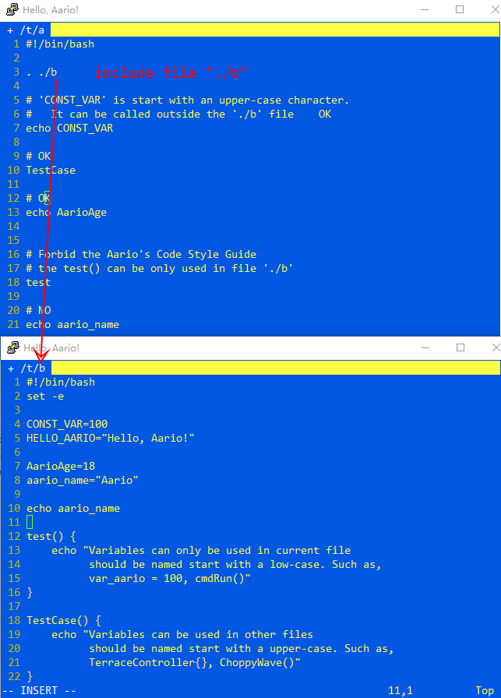
Naming
Variables can only be named start with alpha character only.
Constants should be named with upper-case and underline characters only.
Variables can only be used in current file should be named start with a low-case. Such as, var_aario = 100, cmdRun()
Variables can be used in other files should be named start with a upper-case. Such as, TerraceController{}, ChoppyWave(),

Slide 4
/**
* Commentary Topic
* This is the content of the commentary.
* Keep align it when break lines * @var --> @field @constant @define variable * @param --> @arg parameter * @param --> value-result * @return --> @returns return of function * @throw throw exception * @todo * @see --> @link @tutorial see the link * @author * @version * @example * @extends --> @derive * @note --> @remind note */
class HelloAario extends Aario {
}
Comment

Slide 5
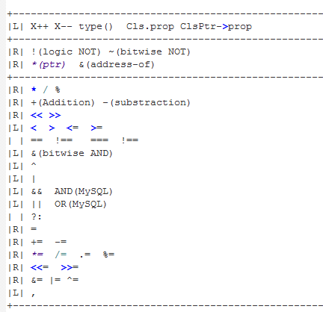
Operator Precedence
PHP Operator Precedence:
http://php.net/manual/en/language.operators.precedence.php
CPP Operator Precedence:
http://en.cppreference.com/w/cpp/language/operator_precedence
C Operator Precedence:
http://en.cppreference.com/w/c/language/operator_precedence

Slide 6
Thanks

